Slide 1
Introduction to Computing for Data Analysis
Pairwise association mining
Richard Vuduc, Ph.D.
Associate Professor
School of Computational Science and Engineering
Formalizing the problem
Notes:
Introduction.
Let’s formalize the analysis problem.

Slide 2

Notes:
We have a set of receipts. (S2-S3)

Slide 3
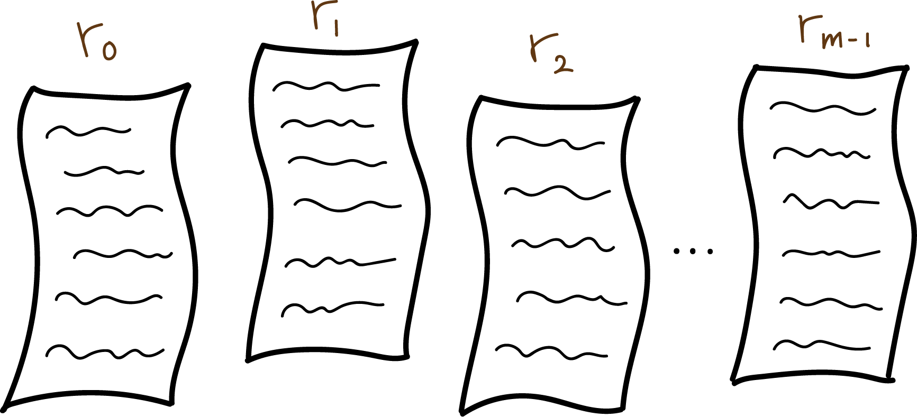
Notes:
We have a set of receipts. (S2-S3)

Slide 4
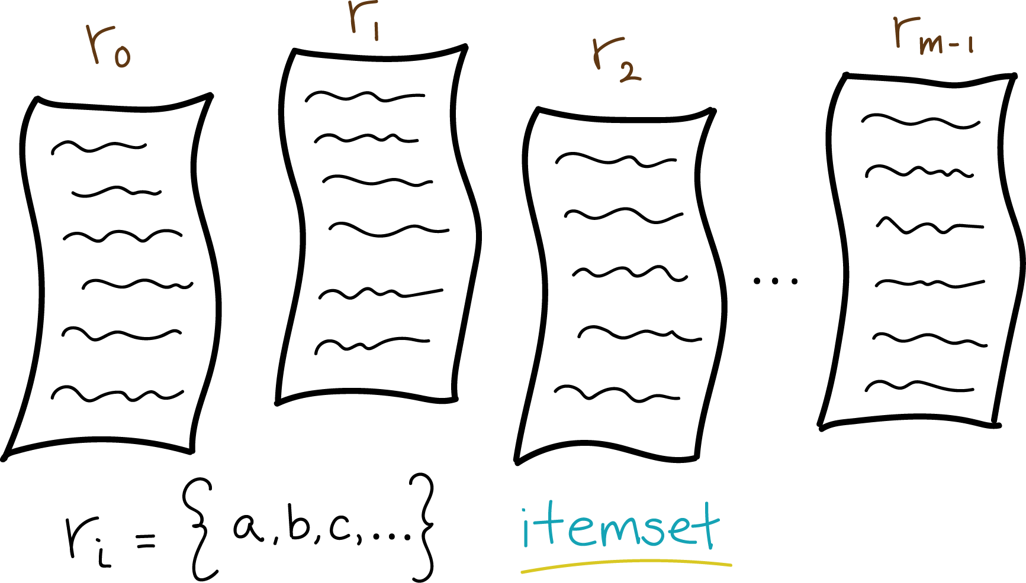
Notes:
Each receipt, r_i, is itself a set of items, or itemset. (S4)

Slide 5
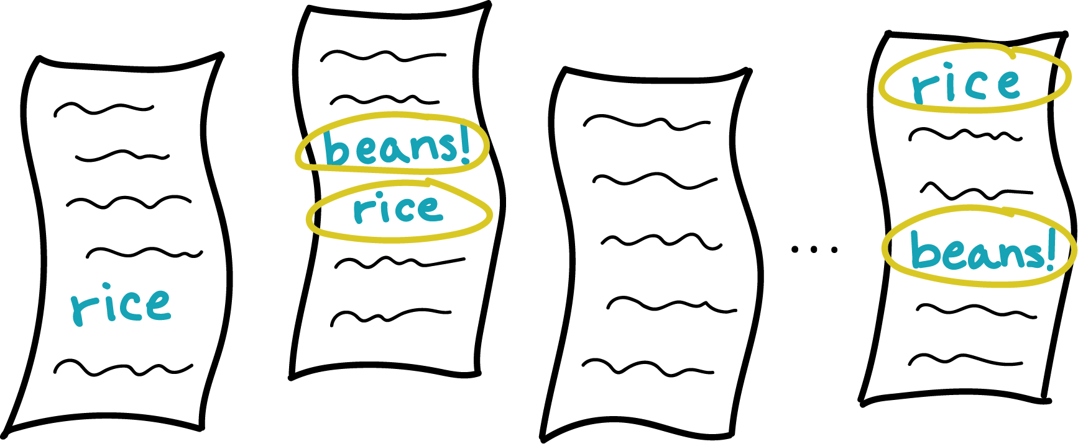
Notes:
[Rachel] So we’re assuming an item appears at most once on an itemset. (S5)
[Rich] Yes, limit one item per customer. (S5)

Slide 6
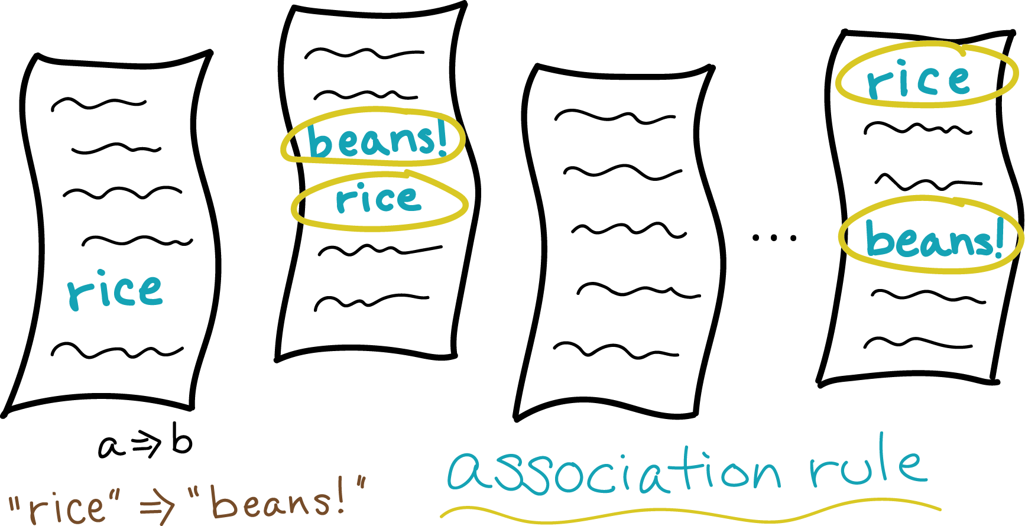
Notes:
Now, we want to find association rules, written as A implies B.
[Rachel] Like “rice implies beans.”
[Rich] Right -- a customer who buys item A, rice, also tends to buy item B, beans.
We’d like to find all instances of this rule that appear “often,” whatever “often” means.

Slide 7
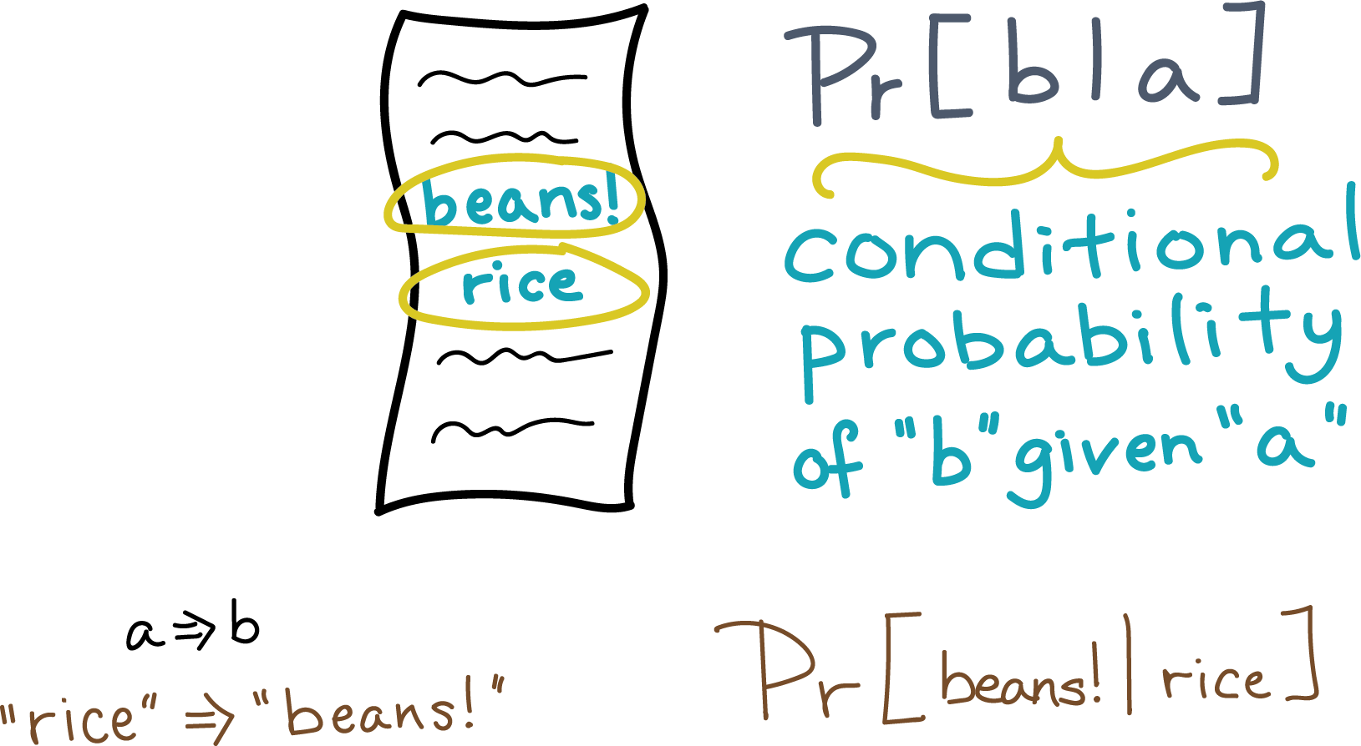
Notes:
[Rachel] Okay. That sounds a lot like conditional probability:
Given that you bought rice, what’s the probability you will buy beans?

Slide 8
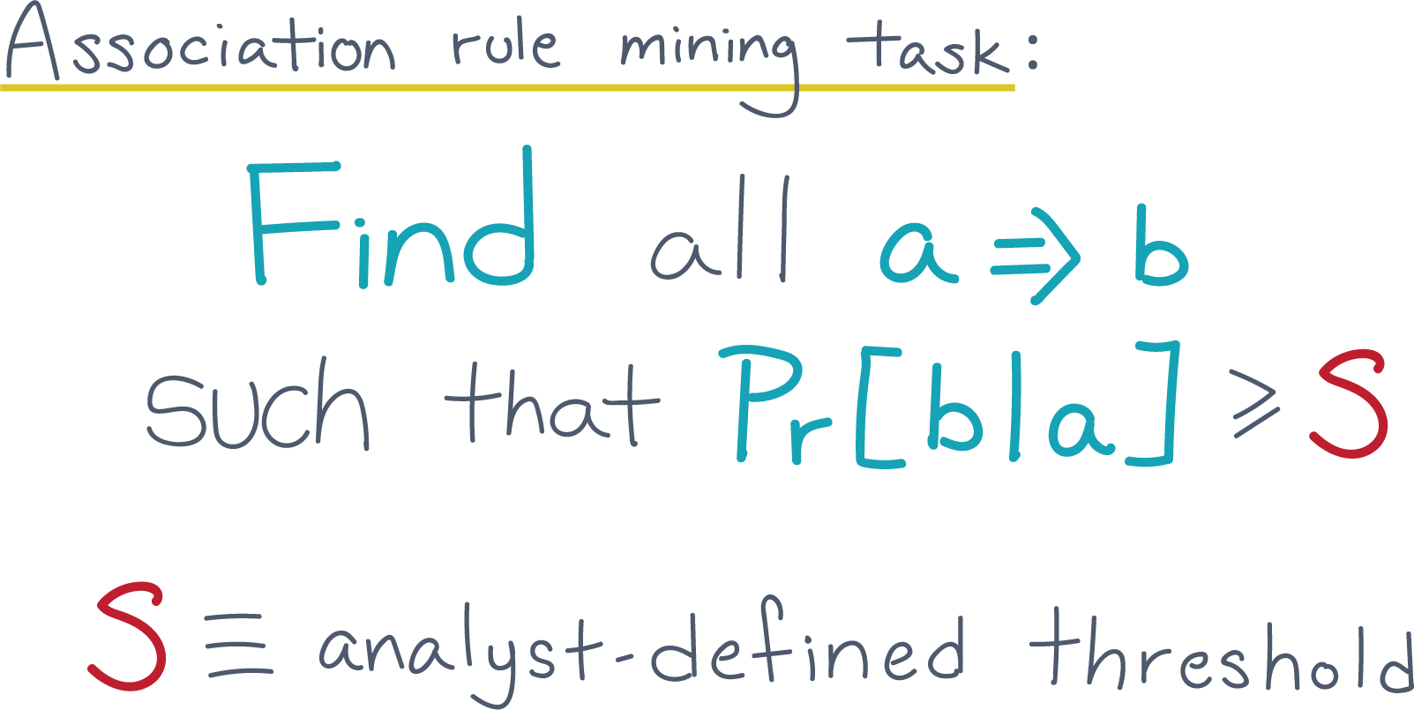
Notes:
[Rich] Yes, that’s great. We just need to estimate the conditional probability for all pairs of items, and then report the list of pairs above some threshold.
So what about an algorithm?
[Rachel] How about a definition first?
Why not start with the definition.

Slide 9
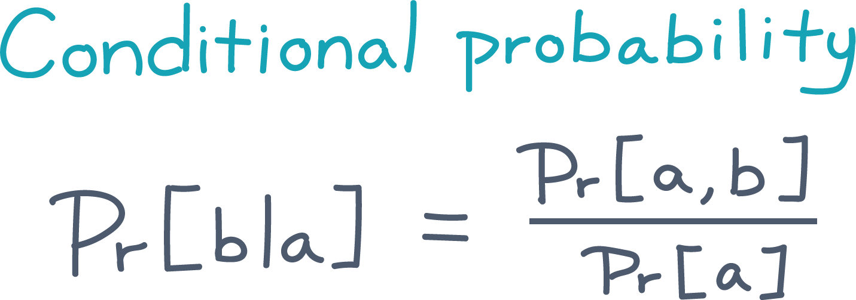
Notes:
[Rich] Of conditional probability, sure.
So one way to define it is in terms of the probability of the joint event, A and B, divided by the total probability of the given event, A.

Slide 10
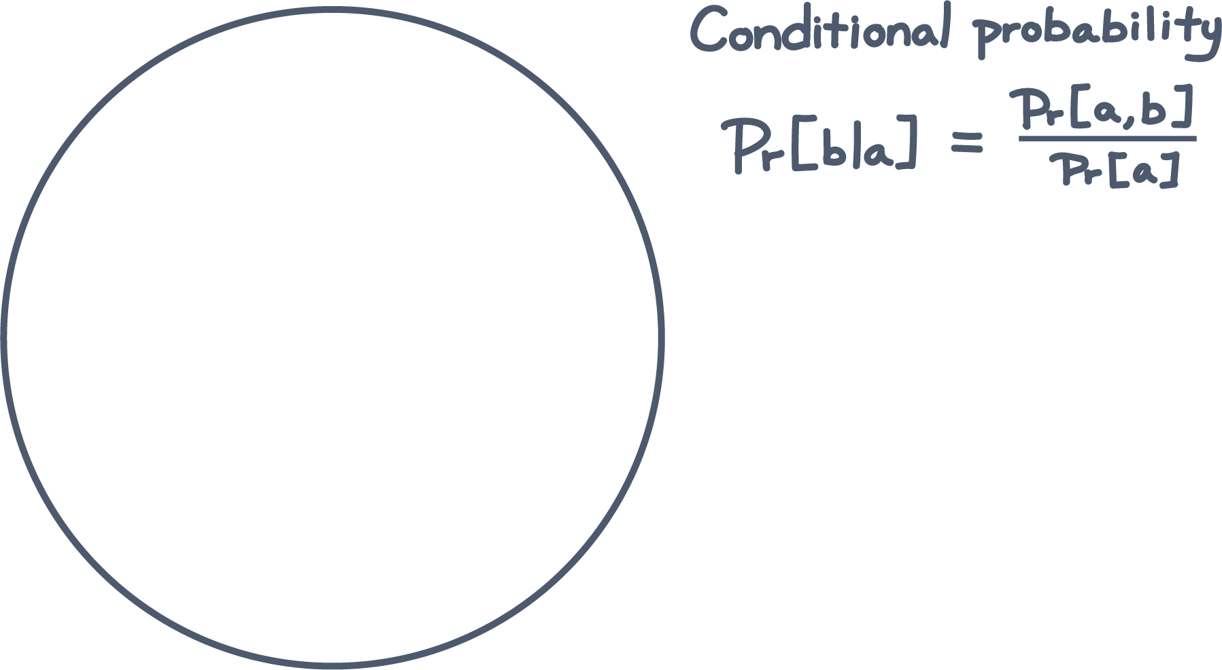
Notes:
transition slide to Slide 11

Slide 11
Notes:
Here’s a picture. (S11)
Imagine the space of all receipts and let’s say you pick one uniformly at random. (S11)

Slide 12
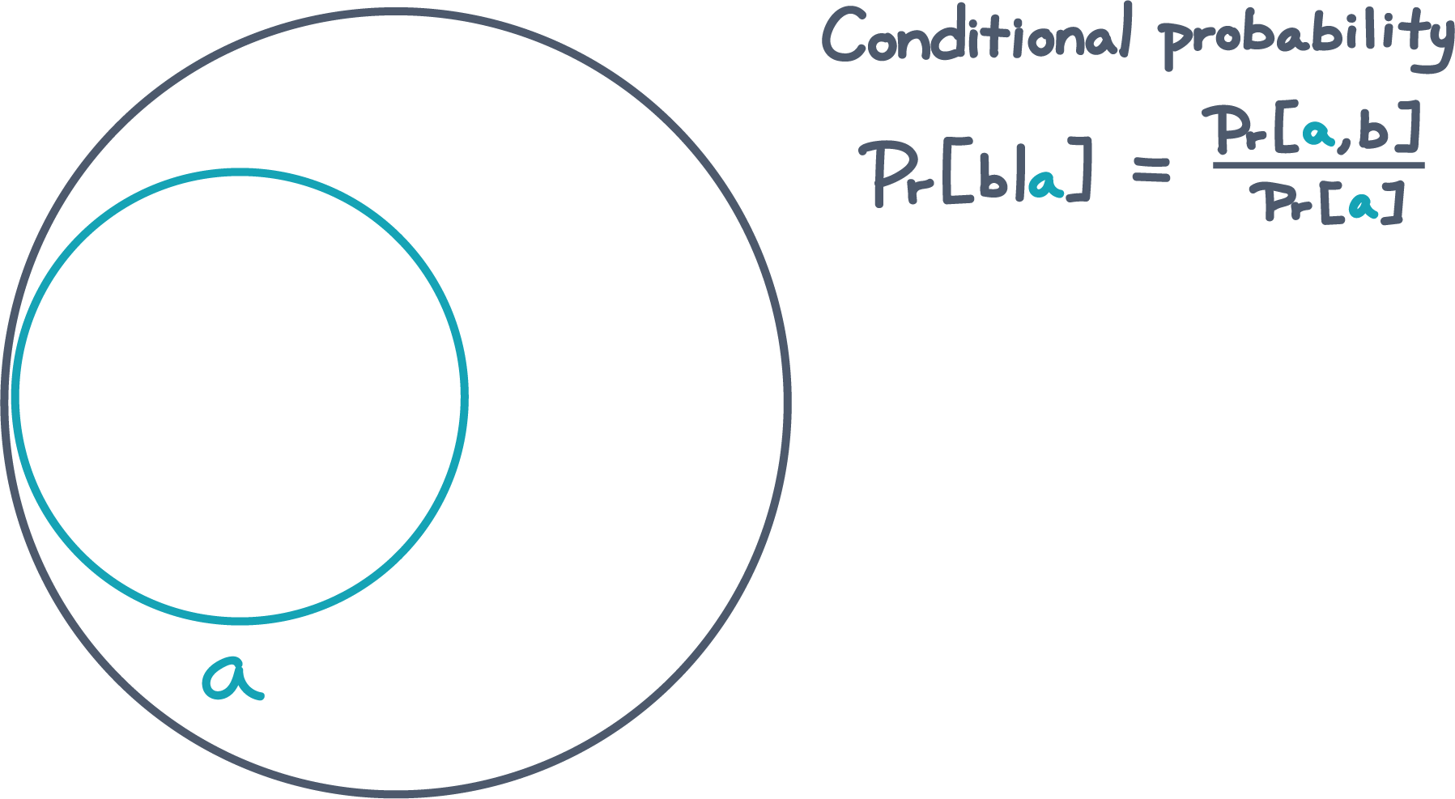
Notes:
There’s some chance that it contains “A”.

Slide 13
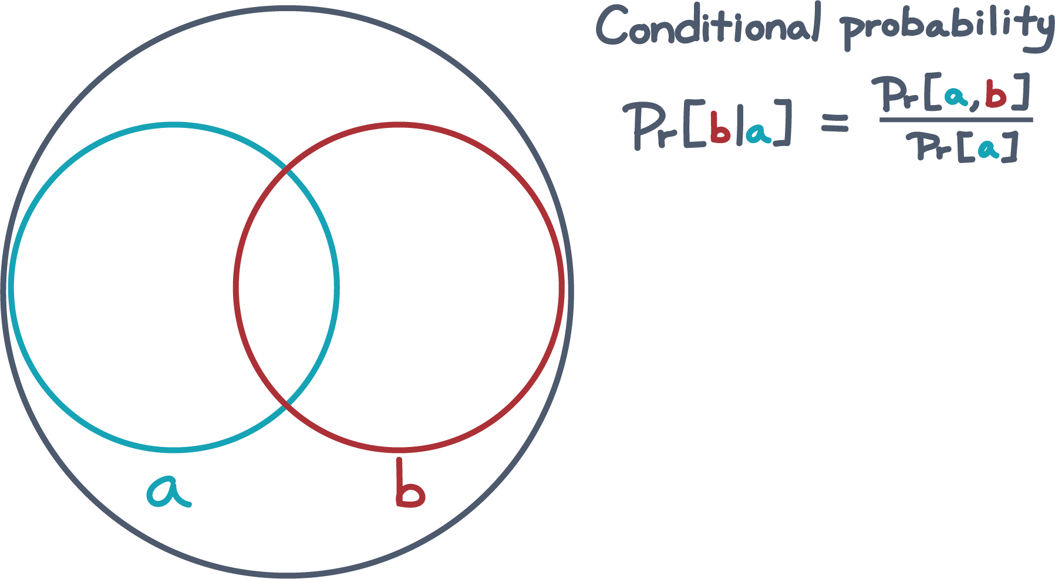
Notes:
There’s also some other chance it contains “B”.

Slide 14
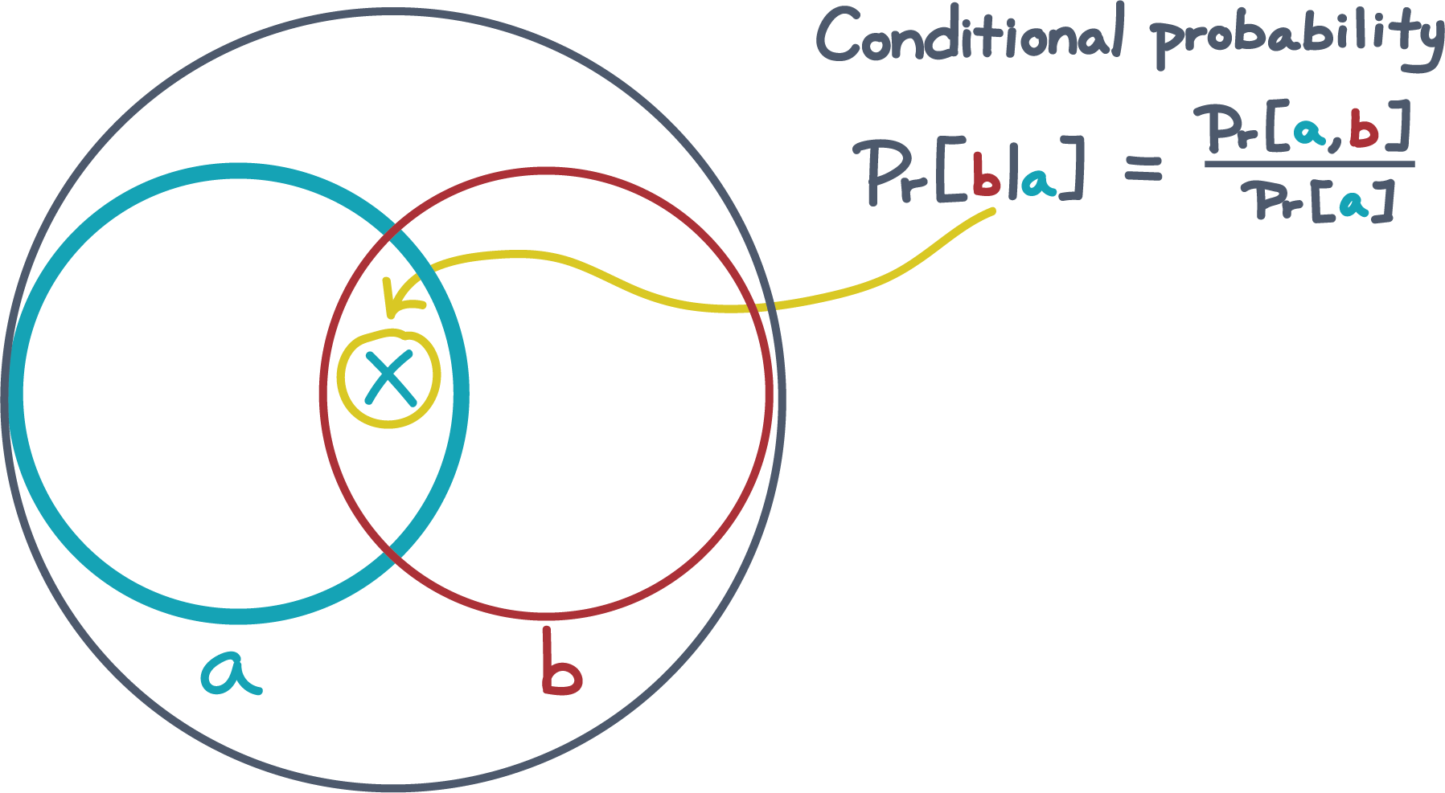
Notes:
Now suppose “A” happens. What’s the chance “B” also happens? (S14)

Slide 15
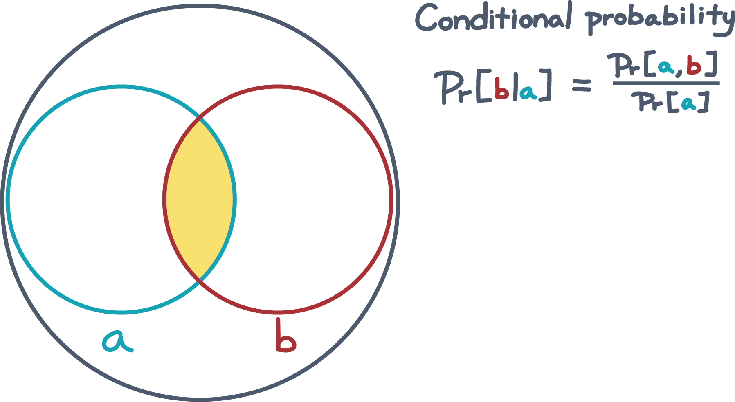
Notes:
In the picture, the fraction of “A” occupied by “B” is the intersection of “A” & “B”. (S15)
Incidentally, that picture suggests a way to estimate the probabilities, given a bunch of receipts. (S15)
[Rachel] Of course. If you have 10 receipts and 3 of them had A, then you would estimate the probability of seeing “A” on a receipt as three-tenths. (S15)
[Rich] Assuming independently drawn receipts, yes, that sounds reasonable. Does that also suggest an algorithm? (S15)

Slide 16
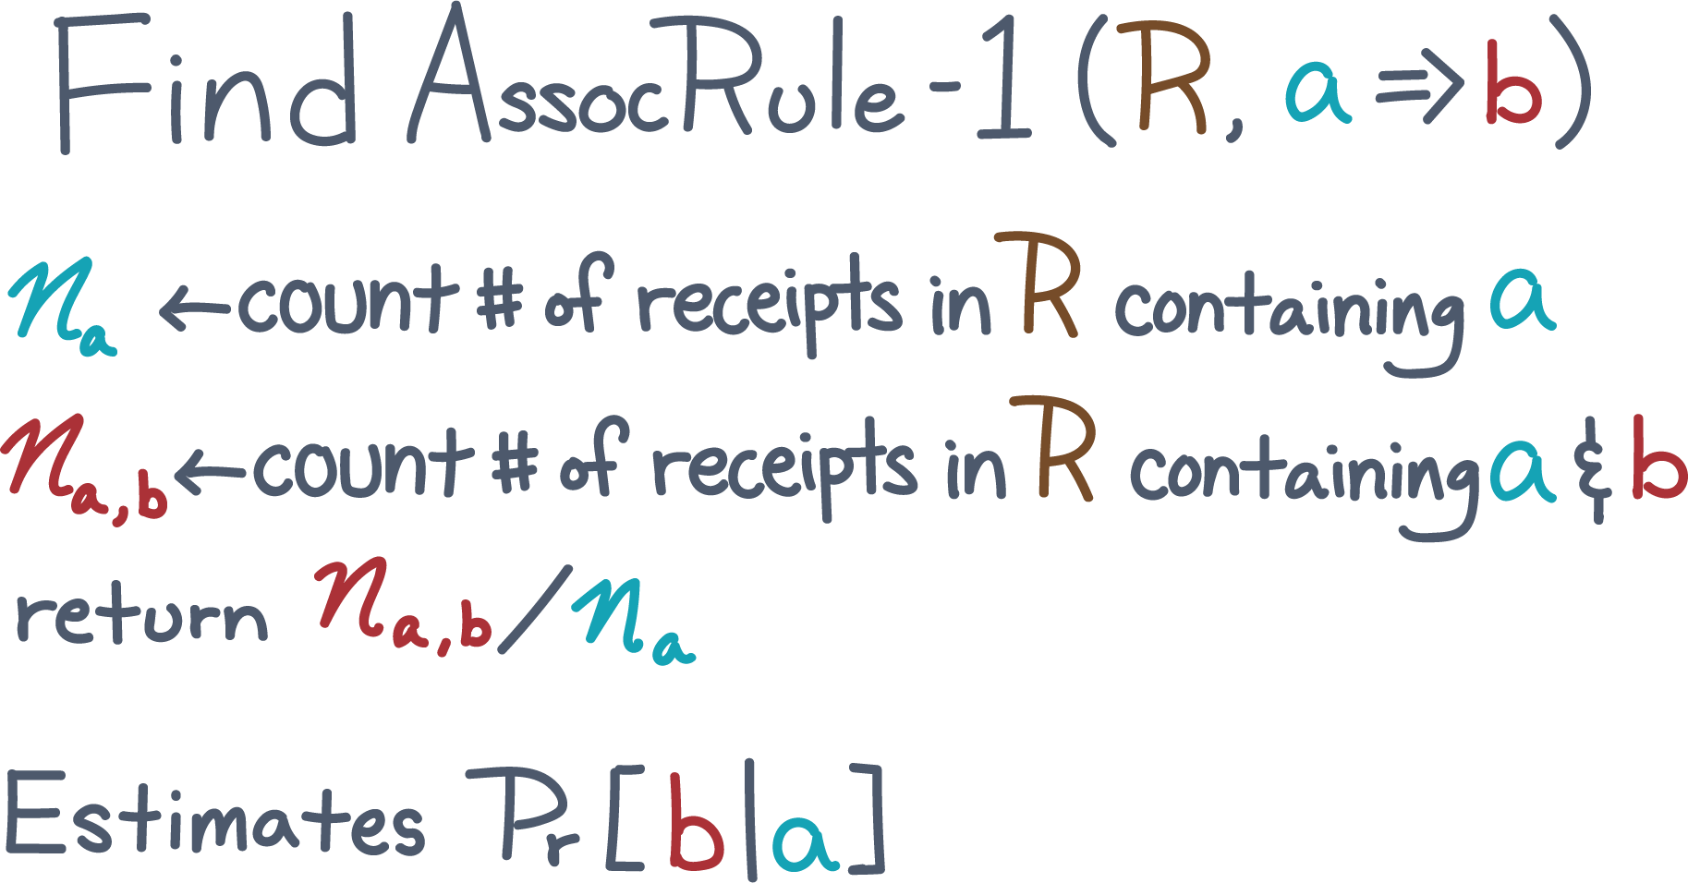
Notes:
[Rachel] Oh sure. (S16)
[Rachel]
You could scan all the receipts.
For each one, count how often item “A” happens, how often “B” happens, and how often both happen.

Slide 17
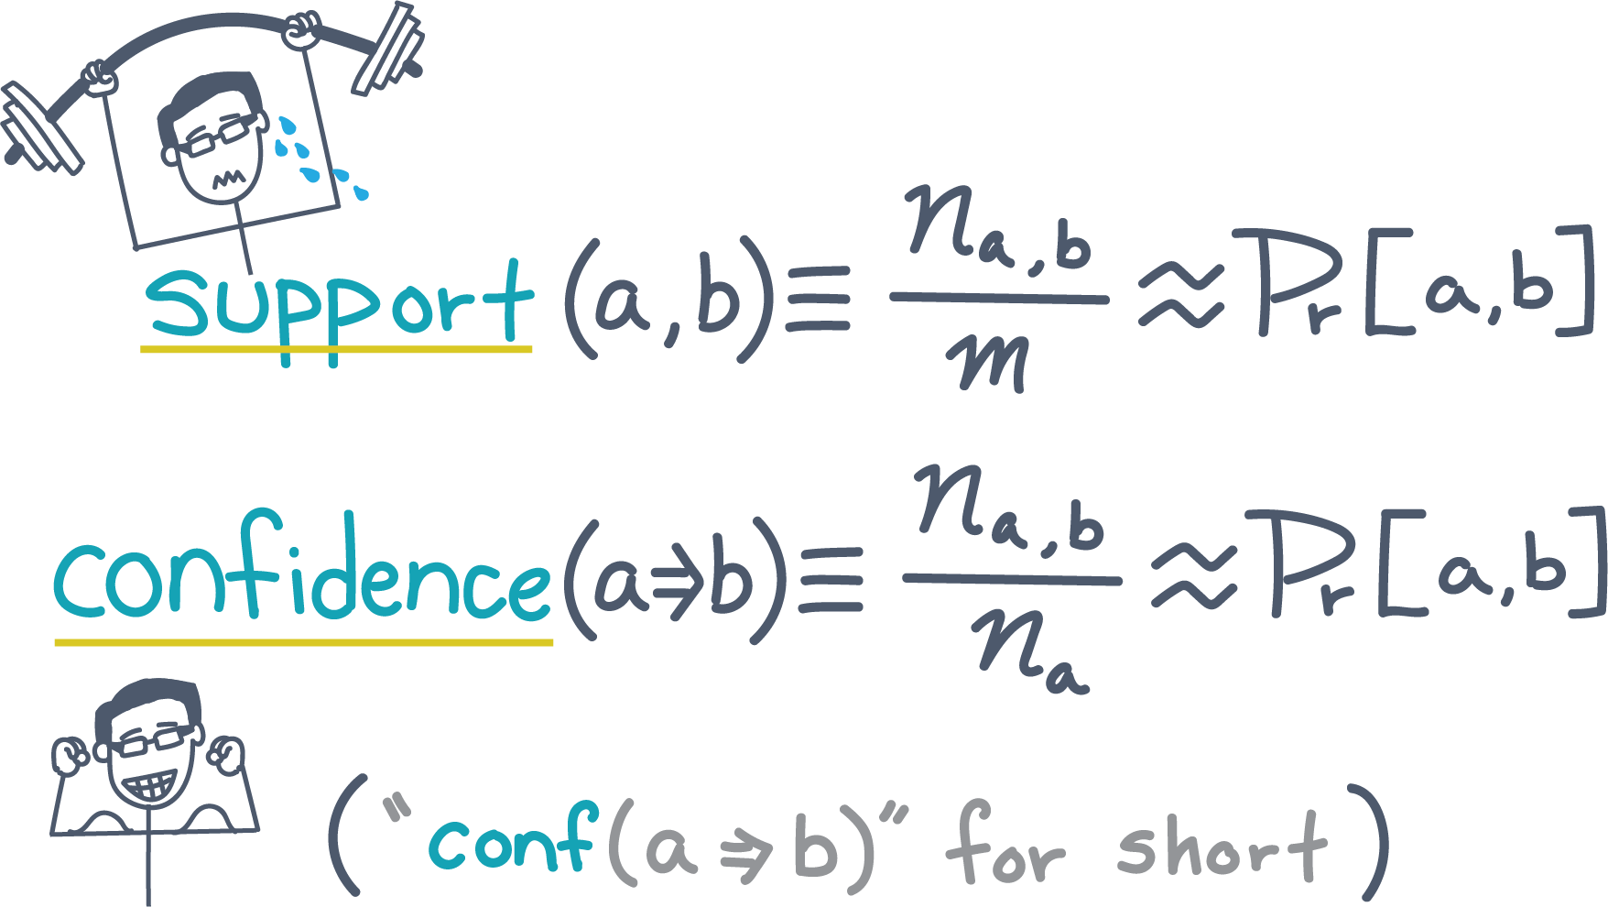
Notes:
[Rich] Awesome.
Can I make a suggestion?
Let’s define two interesting measures, which is what people have done historically.
Take this count of A and B, what you call n_{A,B}.
If you divide by m, that’s an estimate of the joint probability of A and B.
Let’s call that the “support” of A and B.
[Rachel] Okay, the support of A and B estimates their joint probability.
[Rich] Good.

Slide 18
Notes:
Next, let’s call the value n_{A,B} over n_A the “confidence.”
The confidence estimates the conditional probability of B given A.
[Rachel] Got it.
“Support” and “confidence” are easier to say than “joint probability of X and Y” and “conditional probability of Y given X” over and over.
[Rich] Yes, anything to reduce excessive foaming at the mouth, which is my problem, is a good thing.

Slide 19
Notes:
Need a closing

